Slide 1


How do human beings process degraded speech?
Taipei, 18. Dec. 2022
Ya-Ping Chen 陳雅苹
Centre for Cognitive Neuroscience,
University of Salzburg,
Salzburg, Austria

Slide 2
How do human beings process degraded speech?
Study 1 (under review)
How does degraded speech modulate neural speech tracking?
Study 2 (ongoing Taiwan-Austria project)
How does unfamiliar degraded speech modulate neural speech tracking?

Slide 3
Study 1
How does degraded speech modulate neural speech tracking?
Ya-Ping Chen, Fabian Schmidt, Anne Keitel, Sebastian Rösch, Anne Hauswald, & Nathan Weisz

Slide 4
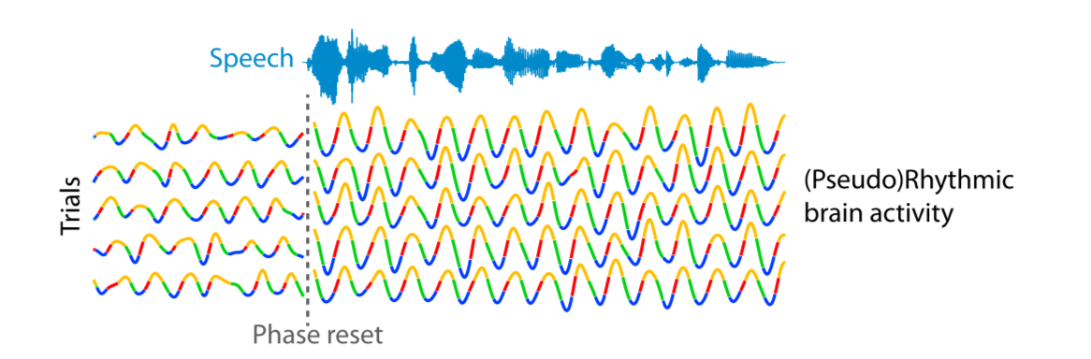
Neural Speech Tracking
a.k.a. Neural Speech Entrainment
temporal fluctuations of speech and neural signals align together
Obleser and Kayser, 2019, Trends Neurosci

Slide 5
Methods for quantifying neural speech tracking
inter-trial phase coherence
e.g. Ding et al., 2014; Rimmele et al., 2015
speech-brain phase coherence
e.g. Peelle et al., 2013; Hauswald et al., 2020
temporal response function (encoding model)
e.g. Ding et al., 2012; Kraus et al., 2021
speech reconstruction (decoding model)
e.g. Puvvada et al., 2017; Decruy et al., 2020
Obleser and Kayser, 2019, Trends Neurosci
Study 1 – 6-level vocoded

Slide 6
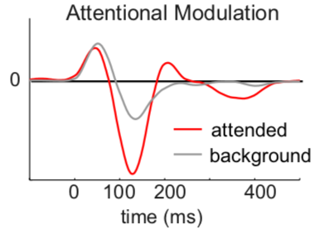
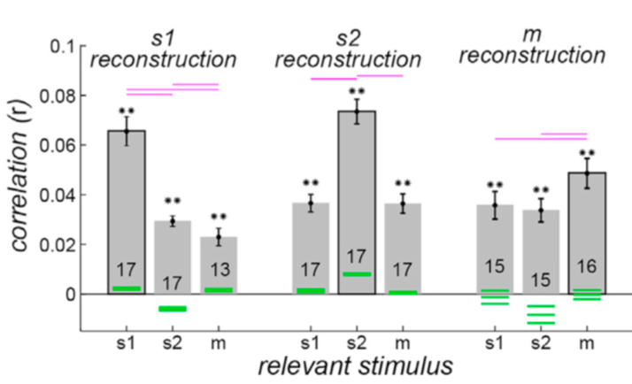
Higher neural speech tracking on attended speech
attend music
attend s1
attend s2
Ding & Simon, 2012
Fiedler et al., 2019
Hausfeld et al., 2018
Study 1 – 6-level vocoded

Slide 7
Research Question
How does variously degraded speech modulate neural speech tracking?
Ding & Simon, 2012
Study 1 – 6-level vocoded

Slide 8


Study Paradigm
MEG recording
Ready?
+
15-180 s
Noun Noun
max. 8 s
Chen et al., 2022, bioRxiv
Study 1 – 6-level vocoded

Slide 9
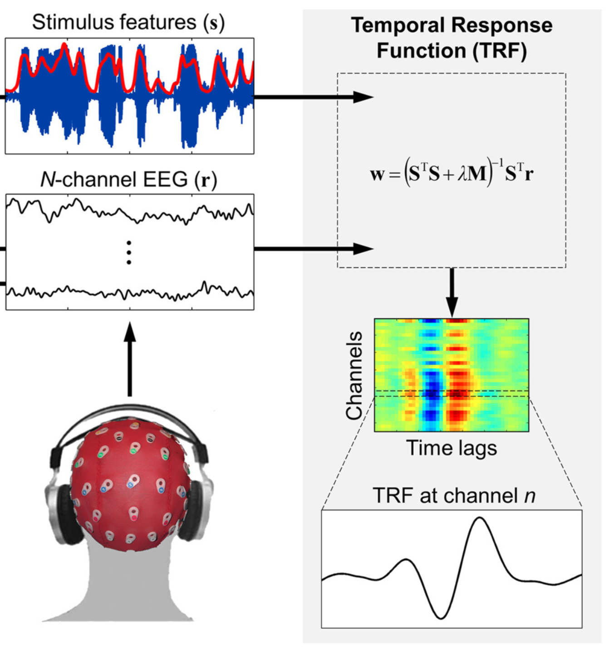
Computing TRFs to depict dynamic neural speech tracking
Speech envelopes (s)
306-channel MEG (r)
Speech Envelope
adapted from Crosse et al., 2016, Front Hum Neurosci
Study 1 – 6-level vocoded

Slide 10
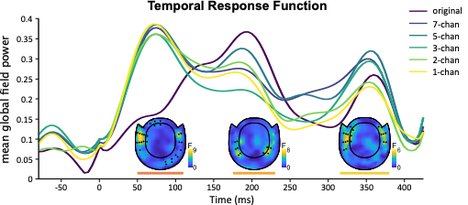
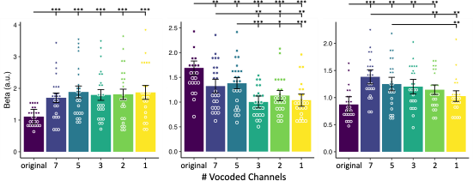
3 distinct TRF components
Chen et al., 2022, bioRxiv
Study 1 – 6-level vocoded

Slide 11
Neural speech tracking shifted among hierarchical speech features over time(?)
Hierarchical Speech Features
low
high
M50_{TRF}
M200_{TRF}
M350_{TRF}
acoustic
linguistic
Time

Slide 12
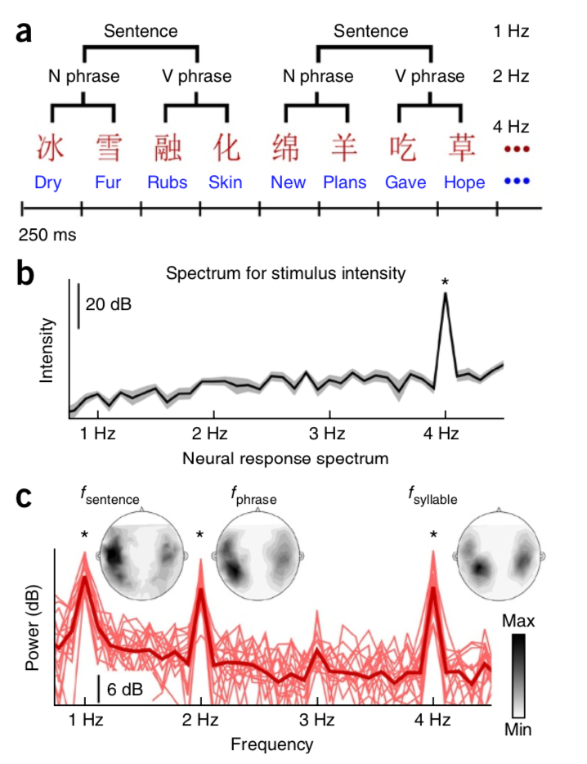
Peak frequency decreases when tracking on a higher linguistic level
Ding et al., 2016, Nat Neurosci
Study 1 – 6-level vocoded

Slide 13
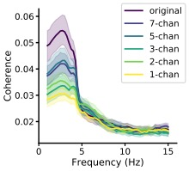
Speech-brain phase coherence decreased with speech intelligibility
Coherence Spectrum
Chen et al., 2022, bioRxiv
Study 1 – 6-level vocoded

Slide 14
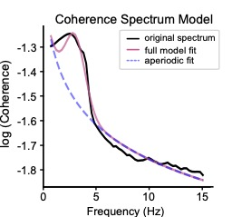
Decomposing coherence spectrum into 5 components
Center Frequency
Bandwidth
Height
Aperiodic Offset
Aperiodic Exponent
adapted from https://fooof-tools.github.io/fooof/
Donoghue et al. (2020) Nature Neuroscience
Study 1 – 6-level vocoded

Slide 15
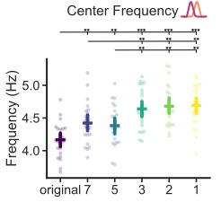
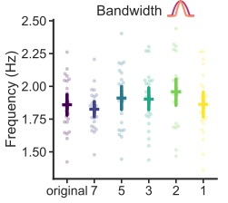
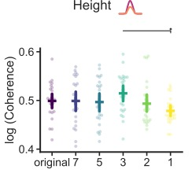
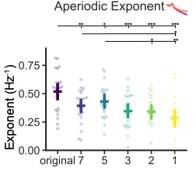
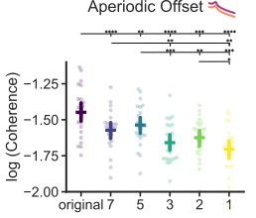
Center frequency of coherence spectrum increased when speech intelligibility decreased (1/2)
Coherence Spectrum
Chen et al., 2022, bioRxiv
Study 1 – 6-level vocoded

Slide 16
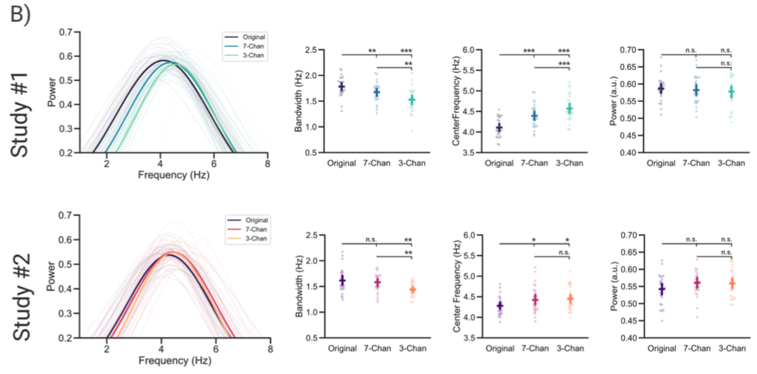
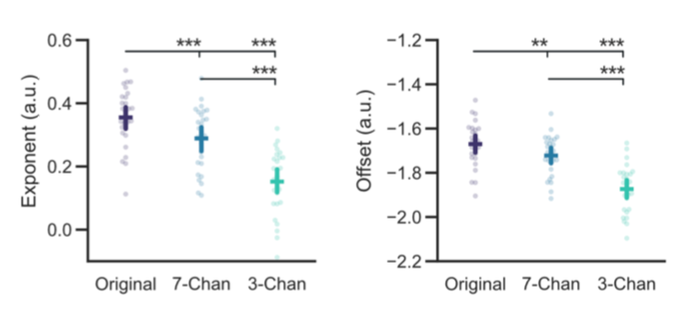
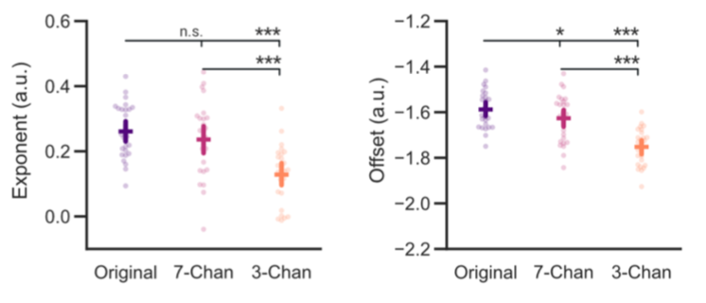
Center frequency of coherence spectra increased when speech intelligibility decreased (2/2)
Bandwidth
Center Frequency
Height
Exponent
Offset
Schmidt et al., 2022, bioRxiv
Study 1 – 6-level vocoded

Slide 17
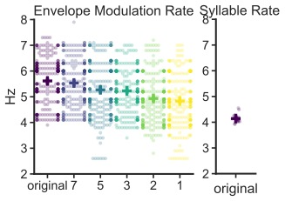
Neural speech tracking shifted to more acoustic level when speech intelligibility decreased

Slide 18
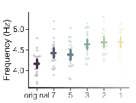
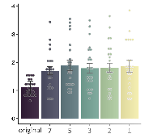
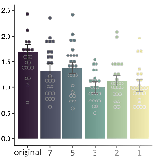
Center frequency explained variances of both M50_{TRF} and M200_{TRF} but in different direction
Center Frequency
Center Freq. (Hz)
higher freq. when more degraded
M50_{TRF}
M200_{TRF}
lower amp. when more degraded
higher amp. when more degraded
Chen et al., 2022, bioRxiv
Study 1 – 6-level vocoded

Slide 19
Conclusion of Study 1
Three neural processing stages (M50_{TRF}, M200_{TRF}, and M350_{TRF}) when listening to continuous degraded speech
Only M200_{TRF} decreased with speech intelligibility.
Neural speech tracking shifted from more linguistic level to more acoustic level when speech intelligibility decreased.
Study 1 – 6-level vocoded

Slide 20
Study 2 (ongoing Taiwan-Austria project)
How does unfamiliar degraded speech modulate neural speech tracking?
PIs: Chih-Mao Huang, Hsu-Wen Huang, Nathan Weisz

Slide 21
According to what we found previously…
How about unfamiliar speech?
How about unfamiliar degraded speech?
How about tonal speech?
Chen et al., 2022, bioRxiv
Study 2 – unfamiliar degraded speech

Slide 22
Experiment paradigms
Mandarin and German version of Little Prince
recorded by a person native to both languages
original, 7- and 3-channel vocoded
Study 2 – unfamiliar degraded speech

Slide 23
Methods
MEG measurement in Taiwan
Participant
native Mandarin speaker in Taiwan
no experience in German
basic knowledge in English
Ready?
+
15-180 s
Blumen Zeit
狐狸 王子
max. 8 s
Study 2 – unfamiliar vocoded speech

Slide 24
Expected results
M50_{TRF}
M200_{TRF}
M350_{TRF}
M50_{TRF}
M200_{TRF}
M350_{TRF}
Study 2 – unfamiliar degraded speech

Slide 26
Expected results
Chen et al., 2022, bioRxiv
Study 2 – unfamiliar degraded speech

Slide 27
Importance of Study 2
vocoded effect on tonal speech
effect of less spectral information and less knowledge of language on shifted neural speech tracking

Slide 28


Anne Keitel
University of Dundee, UK
Sebastian Rösch
Paracelsus Medical University, Austria
Anne Hauswald
Fabian Schmidt
Nathan Weisz
Chih-Mao Huang 黃植懋
National Yang Ming Chiao Tung University, Taiwan
Hsu-Wen Huang 黃緒文
City University of Hong Kong, Hong Kong
https://braindynamics.sbg.ac.at/

Slide 30
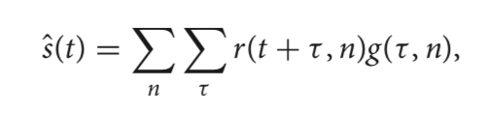
Speech envelope reconstruction accuracy decreases with speech intelligibility
Chen et al., 2022, bioRxiv
Study 1 – 6-level vocoded

Slide 31
Study 1

Slide 32
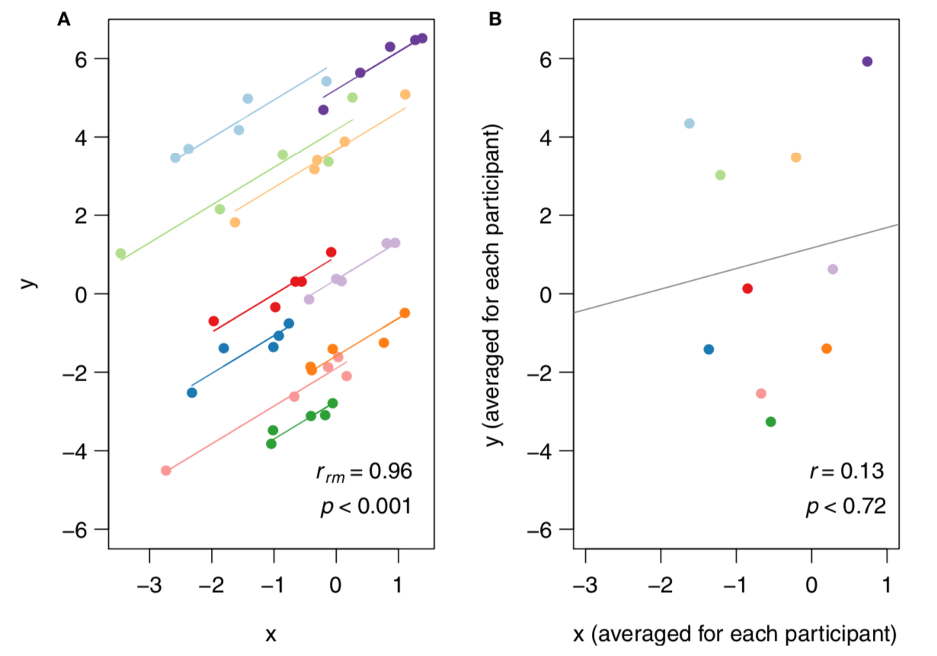
Repeated measures correlation
Bakdash & Marusich, 2017, Front Psychol

Slide 33
Predictive Brain
Could individual differences be explained by individual prediction tendency?
Chen et al., 2022, bioRxiv
Study 2 – unfamiliar vocoded speech

Slide 34

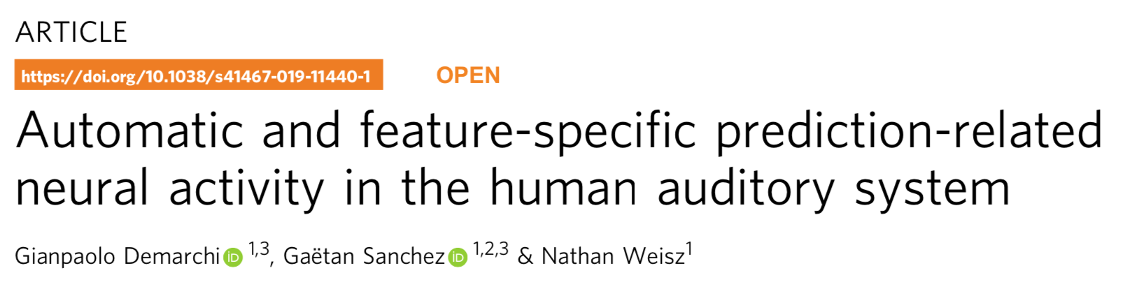
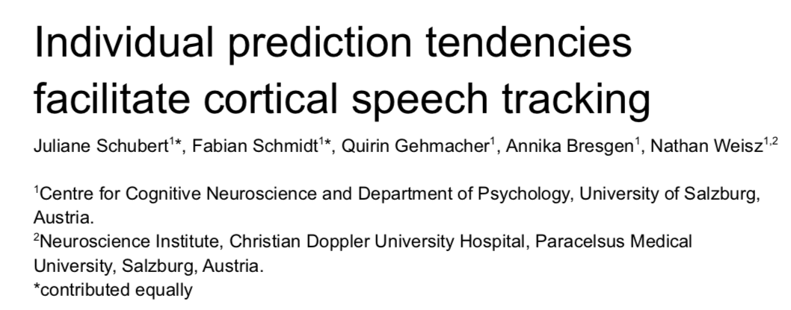
Predictive Brain
Demarchi et al., 2019, Nature Comm
Schubert*, Schmidt* et al., 2023, Cereb Cortex
Study 2 – unfamiliar vocoded speech

Slide 35

Entropy modulation paradigm (1/2)
Demarchi et al., 2019, Nature Comm
Study 2 – unfamiliar vocoded speech

Slide 36
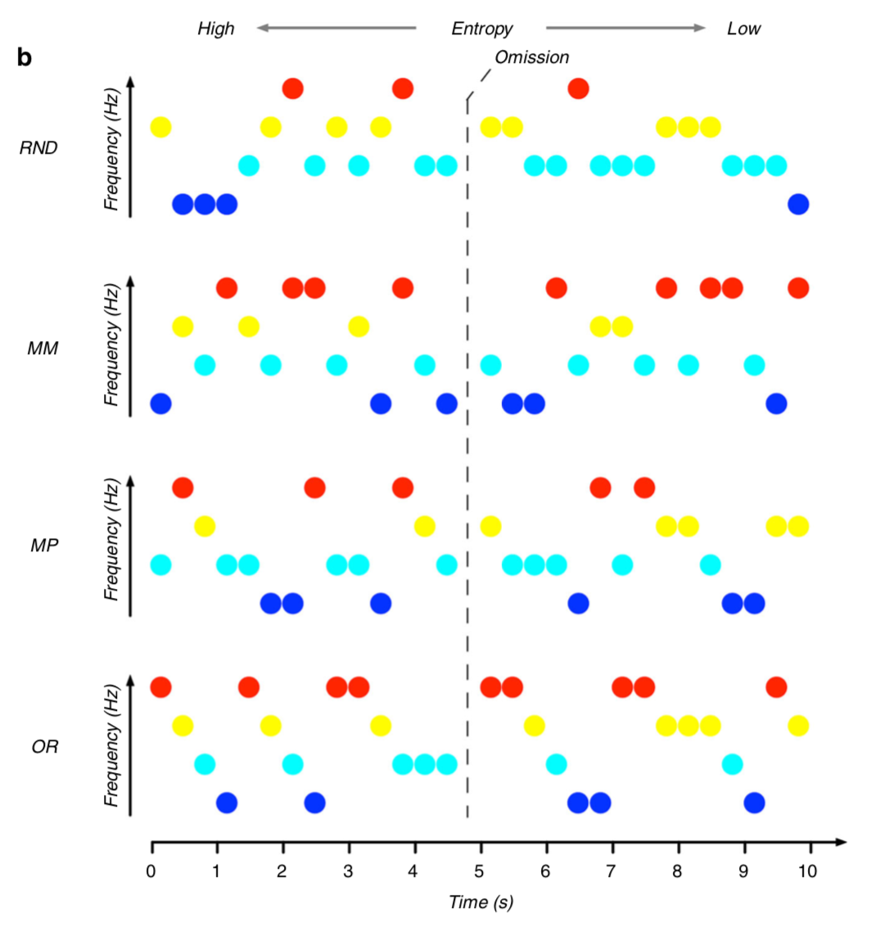
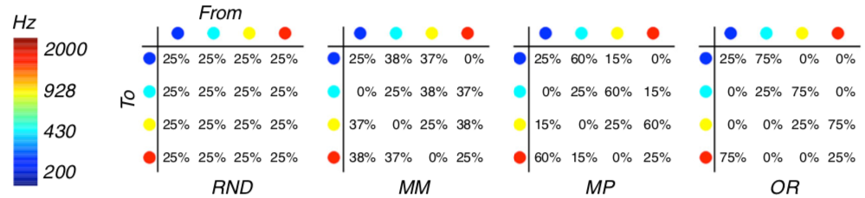
Entropy modulation paradigm (2/2)
(random)
(midminus)
(midplus)
(ordered)
Demarchi et al., 2019, Nature Comm
Study 2 – unfamiliar vocoded speech

Slide 37
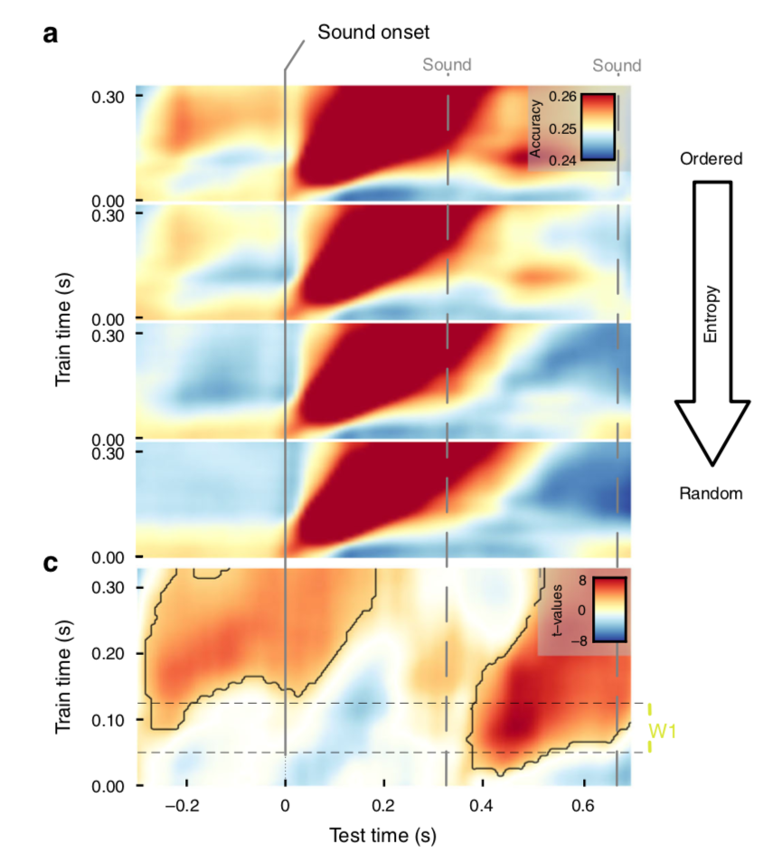
Higher decoding accuracy around pre- and post- sounds found in the ordered sequence
ordered
midplus
midminus
random
Demarchi et al., 2019, Nature Comm
Study 2 – unfamiliar vocoded speech

Slide 38
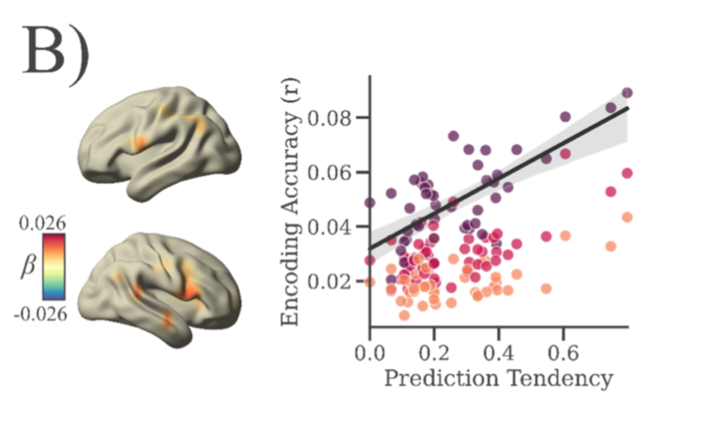
Schubert*, Schmidt* et al., 2023, Cereb Cortex

Slide 39
Study 2
How does speech intelligibility representation of non-CI ear change over a year?
Ya-Ping Chen, Patrick Neff, Sabine Leske, Daniel D.E. Wong, Nicole Peter, Jonas Obleser, Tobias Kleinjung, Andrew Dimitrijevic, Sarang Dalal, Nathan Weisz

Slide 40
Background
Individuals with a cochlear implant (CI) for treating single-sided deafness have experienced improved speech perception in noise (Friedmann et al., 2016; Mertens et al., 2016; Peter et al., 2019).
It is not clear how single-sided CI users’ speech perception improves.
Research Question:
How does neural speech representation of speech intelligibility change over time in single-sided CI users (SSD-CI)?
Study 2 – SSD-CI

Slide 41
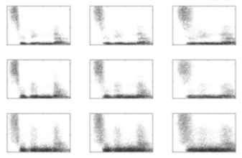

Experiment design
+
3 x 3 Stimulus Manipulation
0.5-1.5 s
Temporal degradation
+
monaural presentation of degraded noun
8-Hz
4-Hz
2-Hz
intelligible
~ 0.6 s
16-band
not well 1 2 3 4
comprehension rating max. 2 s
8-band
Spectral degradation
4-band
2 s
intelligible
unintelligible
Study 2 – SSD-CI
41

Slide 42
Participant
10 single-sided cochlear implant users (5 right-sided + 5 left-sided)
4 female, mean age 46.9
10 age-and-sex matched controls
4 female, mean age 48.2
EEG measurement
1 session for healthy controls
4 sessions for CI users
Pre-op (only healthy ear) & 3 Post-op (3, 6 & 12 months)
Other measurements
Pure tone audiograms (PTA), transiently evoked otoacoustic emissions (TEOAE), speech understanding in noise, questionnaires etc. (Peter et al., 2019)
CI Sub ID | Age at CI Activation (yrs) | Duration of Deafness (yrs)
CI1 | 27 | 1.0
CI2 | 36 | 1.7
CI3 | 42 | 1.6
CI4 | 45 | 4.6
CI5 | 48 | 0.8
CI6 | 48 | 1.5
CI7 | 50 | 1.5
CI8 | 54 | 1.2
CI9 | 56 | 1.3
CI10 | 63 | 1.4
Study 2 – SSD-CI

Slide 43
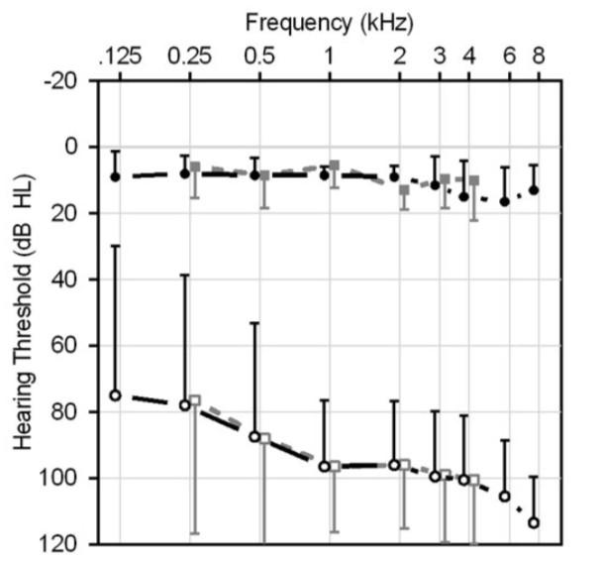
Pre-operative Pure Tone Audiogram (PTA) confirmed the single-sided deafness
Healthy Control
SSD-CI
Peter et al., 2019, Swiss Med Wkly
Study 2 – SSD-CI

Slide 44
Behavioral performance of both ears
improved over time
Study 2 – SSD-CI

Slide 45
Using representational similarity analysis (RSA) to depict discriminability of speech intelligibility
Study 2 – SSD-CI

Slide 46
Quantifying shared representations between SSD-CI and healthy controls
Study 2 – SSD-CI

Slide 47
Decoding accuracy changes over time
Study 2 – SSD-CI

Slide 48
Discriminability of SSD-CI users’ non-CI ear improved over time
Non-CI Ear
CI Ear
Study 2 – SSD-CI

Slide 49
Shared representations between non-CI ears and healthy ears increased over time
Study 2 – SSD-CI

Slide 50
Conclusion of Study 2
The CI benefits not only the CI ear but also the non-CI ear.
Cortical speech processing after CI implantation gradually normalizes towards normal functioning within months.
Study 2 – SSD-CI

